Slide 1
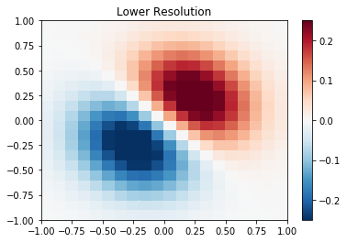

INTERPOLATION
What is interpolation?
Finding a function that runs through each of the existing data points
Why do we interpolate data?
When we desire data where data does not currently exist
So we estimate data in-between existing data points!
Examples of interpolation
Filling in missing data, irregular data, or data we otherwise don’t have but want
Example: changing resolution of spatial data
Note: Extrapolation is estimating data outside of bounds of existing data

Slide 2
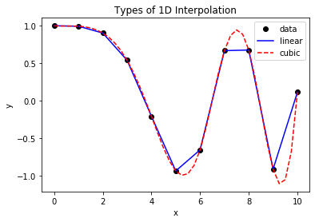
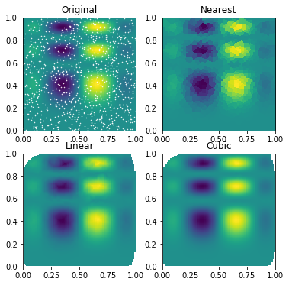
INTERPOLATION
Common types of interpolation
Linear: a straight line between data points
Cubic spline: third-order polynomial between data points
Nearest neighbor: use value of closest existing data point
Extensions of all of the above for spatial (2D+ data!)
- Example: bilinear interpolation
Other types for spatial include:
Barnes (frequently used in meteorology for irregularly spaced observations)
Kriging (statistical method based on relationships in your data)
Some Considerations
Are your observations on a regular or irregular grid?
Is enough existing data present around the missing data to safely interpolate?

